Slide 1


EBU4202: Digital Circuit Design
Autonomous Sequential Circuit Design
Dr. Md Hasanuzzaman Sagor (Hasan)
Dr. Chao Shu (Chao)
Dr. Farha Lakhani (Farha)
Dr. Fatma Benkhelifa
School of Electronic Engineering and Computer Science,
Queen Mary University of London,
London, United Kingdom.

Slide 2
Overview: Autonomous Sequential Circuit Design
* Introduction
* Bistable Elements
* Latches & Flip-Flops
* Analysis Procedure
* Design Procedure
Chapter 7 – “Digital Design: Principles and Practices” book
Notes:
Analysis Procedure: Section 7.3 of main textbook.

Slide 3
Introduction
Autonomous circuits do not have primary inputs, they have only secondaries (plus a clock signal).
Secondaries, form input circuits, and consist of combinational logic that feeds back from flip-flop outputs to flip-flop inputs.
There may also be output logic.
Notes:
Generates an output without having an primary input
It has secondary inputs, usually fed back from FF output to FF inputs.

Slide 4
Introduction
Method
Draw-up a table of present and next states.**Need to take account of the characteristic equation of the flip-flop
Draw a Karnaugh map for each next state output in terms of the present state.
Minimise the logic using Karnaugh map simplification techniques.
Draw-up the corresponding circuit diagram for the FSM.
Notes:
Present states could be given or hints are given. First main part is to applying the characteristic eqn, find the inputs of flip-flop.
**Find the inputs of the flip flop according to the next stages.
Draw the K map for expressions of each inputs of FF.

Slide 5
Example 1: D-type flip-flop
Design an autonomous sequential circuit using D-type flip-flops to generate the following sequence of states: 001, 100, 010, 101, 110, 111, 011.
Step 1 – Complete a table of present and next states.
To complete this task we need to consider the functional operation (i.e. the characteristic equation) of the flip-flop used.
D-type flip-flops have been used. So, input to A flip-flop, i.e. D_{A}, is equal to next state of A flip-flop Q_{A}* i.e.: D_{A} = Q_{A}*
Notes:
Analysis: circuit diagram → state diagram.

Slide 6
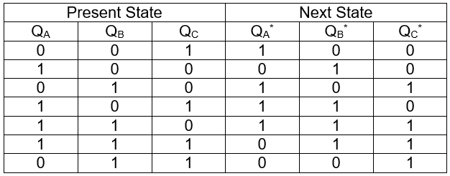
Example 1: D-type flip-flop
The table of present and next states is given below.
Step 2 – Draw a Karnaugh map for each next output state in terms of the present state.
D inputs D_{A} D_{B} D_{C}
Notes:
D inputs table part is avoided as it is actually same as Q*. DA=Q*A DB=Q*B DC=Q*C. Good practice is to make it.
Qc is LSB.

Slide 7
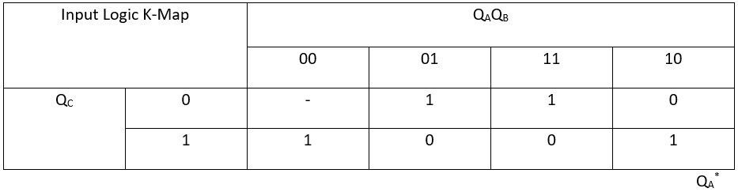
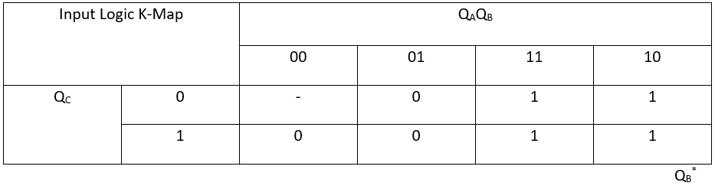
Example 1: D-type flip-flop
Q_{A}* = D_{A} = Q_{B}Q_{C}’ + Q_{B}’Q_{C} = Q_{B} ⊕ Q_{C}
Q_{B}* = D_{B} = Q_{A}
Characteristic equation
Notes:
Da = Qa*
Group the 1’s and find out the simplest expression for DA DB and DC

Slide 8

Example 1: D-type flip-flop
Q_{C}* = D_{C} = Q_{B}
Notes:
Analysis: circuit diagram → state diagram.

Slide 9
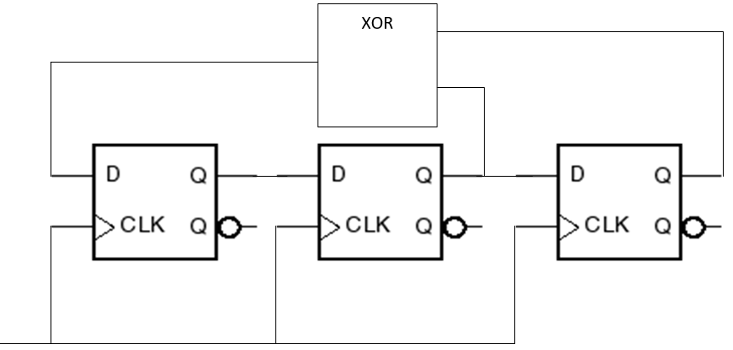
Example 1: D-type flip-flop
Step 4 – We can now draw the circuit diagram for the FSM.
A
A
B
B
C
C

Slide 10
Example 2: JK flip-flop
Design a 3 bit binary counter using JK flip-flops.
We need 3 flip-flops, one for each bit.
Let’s recap. the steps in the method

Slide 11
Example 2: JK flip-flop
Method
Draw-up a table of present and next states. Need to take account of the characteristic equation of the flip-flop
Draw a Karnaugh map for each next state output in terms of the present state.
Minimise the logic using Karnaugh map simplification techniques.
Draw-up the corresponding circuit diagram for the FSM.
Notes:
Analysis: circuit diagram → state diagram.

Slide 12
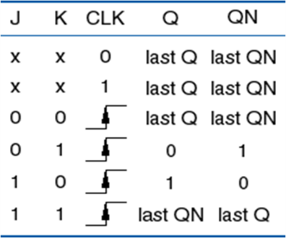
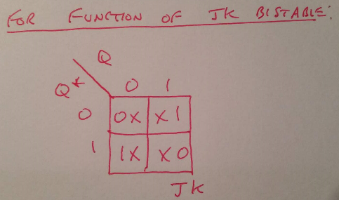
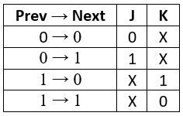
Example 2: JK flip-flop
Step 1 – Complete the table of present and next states.
Use the JK transition table to complete entries in the table corresponding to the inputs to J and K.

Slide 13
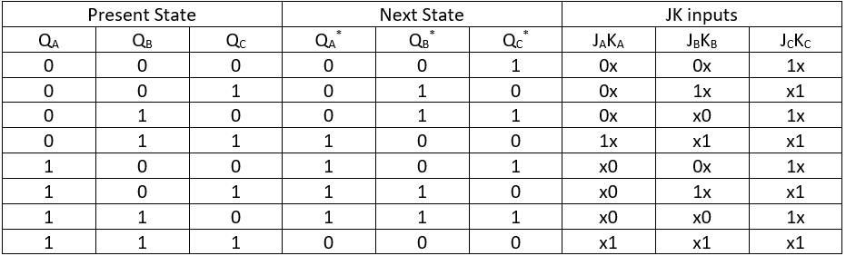
Example 2: JK flip-flop
The table of present and next states is given below.
Steps 2 & 3 – Now draw 6 Karnaugh maps, one for each of the J and K inputs, in terms of the present states

Slide 14
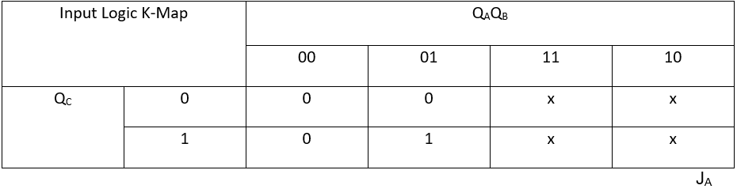
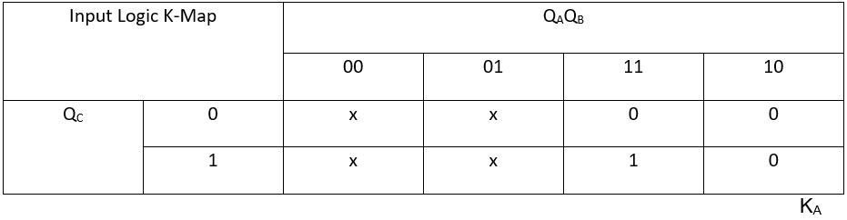
Example 2: JK flip-flop
J_{A} = Q_{B}.Q_{C}
K_{A} = Q_{B.}Q_{C}
Notes:
K Map for each FF inputs. 6 here. Ja Ka Jb……..

Slide 15

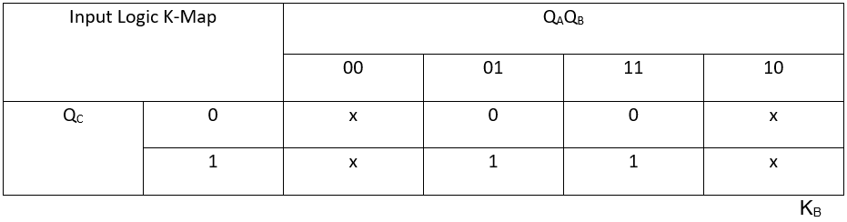
Example 2: JK flip-flop
J_{B}=Q_{C}
K_{B}=Q_{C}
Notes:
Analysis: circuit diagram → state diagram.

Slide 16
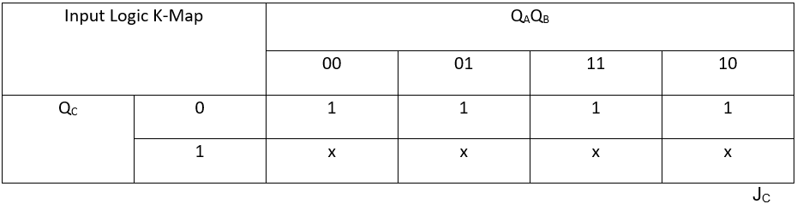

Example 2: JK flip-flop
J_{C}=1
K_{C}=1
Notes:
Analysis: circuit diagram → state diagram.

Slide 17
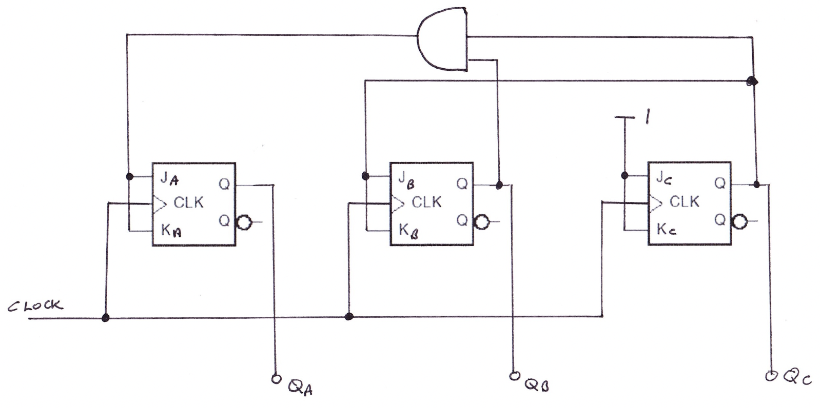
Example 2: JK flip-flop
Step 4 – We can now draw the circuit diagram for the FSM.
Notes:
Draw the circuit diagram

Slide 18
Example 3: JK flip-flop
Design a 6-state counter using the first six binary numbers. Use JK flip-flops.
What is the result if either of the cannot happen input states (marked – in the maps) does happen?
Step 1 – Complete the table of present and next states.
Use the JK transition table to complete the table for the inputs to J and K.

Slide 19
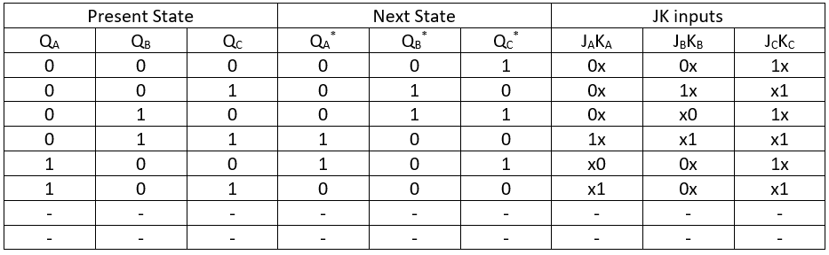
Example 3: JK flip-flop
The table of present and next states is given below
Steps 2 & 3 – Now draw the 6 K-maps for the J and K inputs.
Notes:
Analysis: circuit diagram → state diagram.

Slide 20
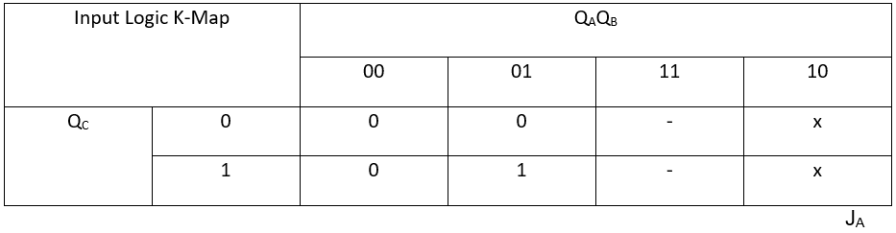
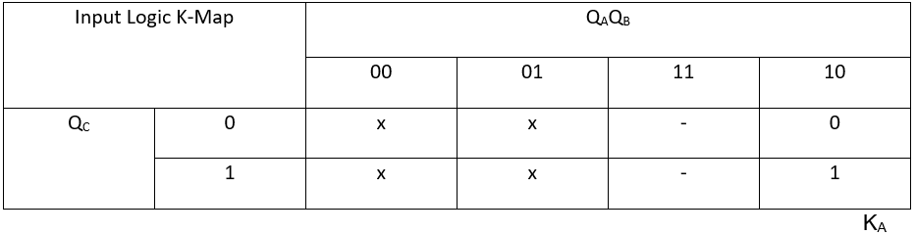
Example 3: JK flip-flop
J_{A}=Q_{B}.Q_{C}
K_{A}=Q_{C}
Notes:
Analysis: circuit diagram → state diagram.

Slide 21


Example 3: JK flip-flop
J_{B}=Q_{A}′.Q_{C}
K_{B}=Q_{C}
Notes:
Analysis: circuit diagram → state diagram.

Slide 22


Example 3: JK flip-flop
J_{C}=1
K_{C}=1
Notes:
Analysis: circuit diagram → state diagram.

Slide 23
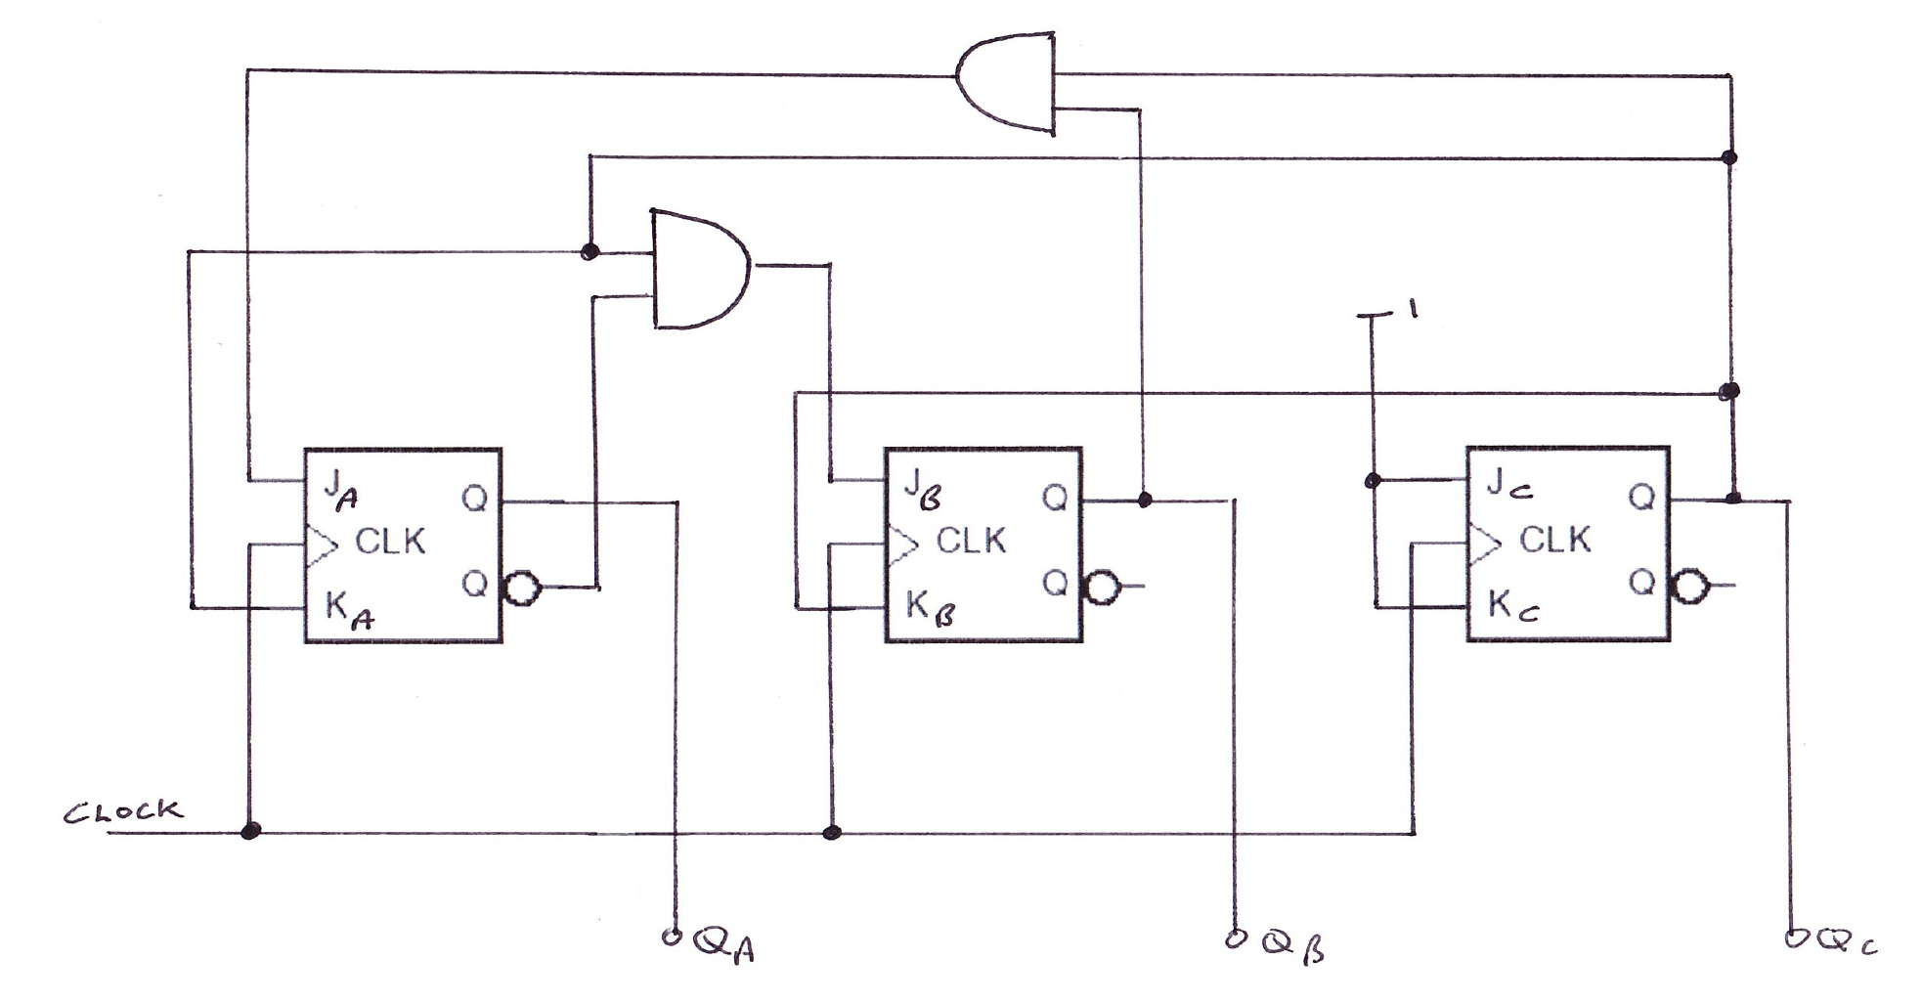
Example 3: JK flip-flop
Step 4 – Then we can draw the circuit diagram………
Notes:
Analysis: circuit diagram → state diagram.

Slide 24
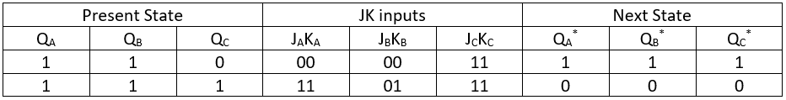
Example 3: JK flip-flop
To think about the “cannot happen” input states……… Because we have minimised the logic circuits by grouping “1s” with “cannot happens” and “don’t cares”, we are forcing the next states of a cannot happen.
We can look at our K-maps and make the following table:

Slide 25
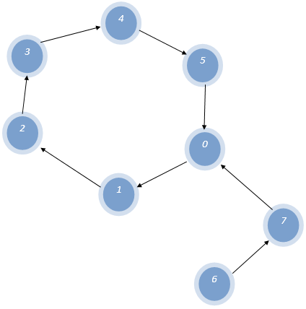
Example 3: JK flip-flop
So, if state 6 is entered the next state is state 7, and if state 7 is entered the next state is state 0.
So the state diagram is:

Slide 26
Example 4: T flip-flop
Repeat example 3 this time using T-flip-flops (i.e. 6 state counter using the first 6 binary numbers).
Step 1 – Complete the present state and next state table, adding the toggle input (T) of each flip-flop. Put a 1 for the T input if the bit needs to change state.
Notes:
Analysis: circuit diagram → state diagram.

Slide 27
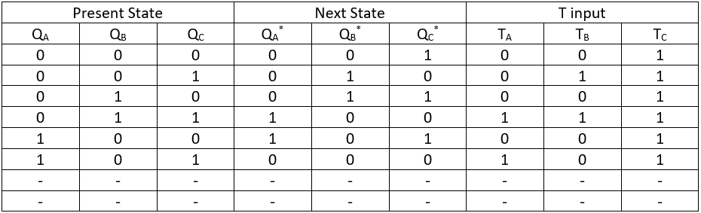
Example 4: T flip-flop
The table of present and next states is given below
Steps 2 & 3 – Now draw the 3 K-maps, one for each flip-flop input.

Slide 28

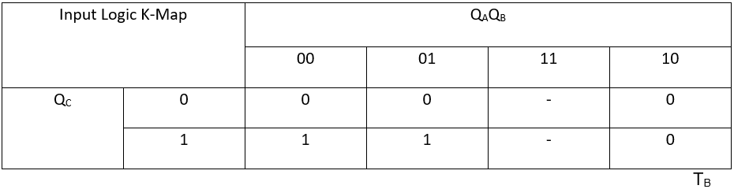
Example 4: T flip-flop
T_{A} = Q_{A}.Q_{C} + Q_{B.}Q_{C}
T_{B}=Q_{A}′.Q_{C}
Notes:
Analysis: circuit diagram → state diagram.

Slide 29

Example 4: T flip-flop
T_{C}=1
Step 4 – Now we can draw the circuit diagram…….
Notes:
Analysis: circuit diagram → state diagram.

Slide 30
Example 4: T flip-flop
Circuit Diagram:
T_{A} = Q_{A}.Q_{C} + Q_{B.}Q_{C} = Q_{C}.(Q_{A} + Q_{B}) T_{B}=Q_{A}′.Q_{C ,} T_{C}=1
Notes:
Analysis: circuit diagram → state diagram.

Slide 31
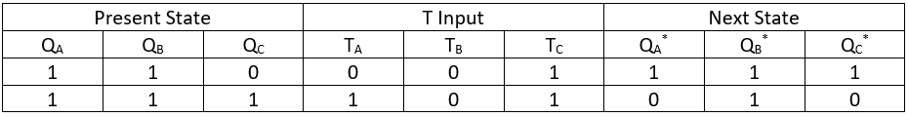
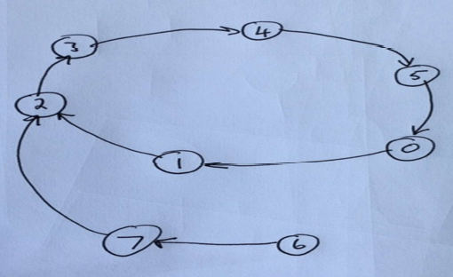
Example 4: T flip-flop
For the two cannot happen states based on our groupings for the T inputs a “1” in the T input means “change state”
So, if state 6 is entered the next state is state7. If state 7 is entered the next state is state 2.
Notes:
Same as before. Put QaQbQc values in TaTbTc expressions.
Extra: Can you now design something which will keep displaying 2>0>1>5?
010>000>001>101
Can you design counter which will count 0-25, then repeat? 0000-0001 up to 1101-0000

